Slide 1
POE PART 1 PRESENTATION

Slide 2
agenda
Greeting
Logo
Design/ UI
Split filter
Final product

Slide 3
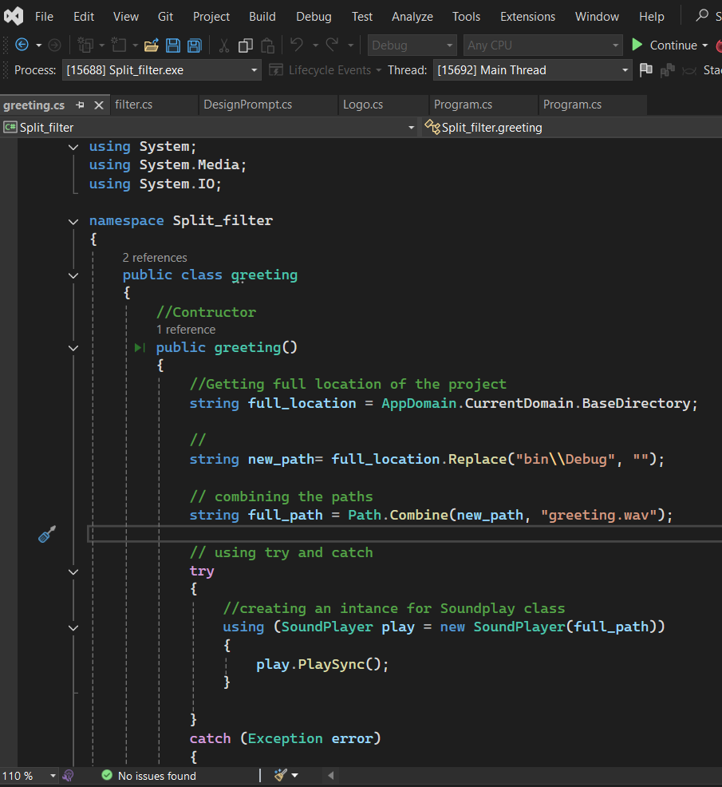
Greeting code : .In this code I first started by exporting the Using System.Media to ensure that the audio will play. . Made use of a BASE directory to store and get the location of the audio.

Slide 4
Logo code

Slide 5
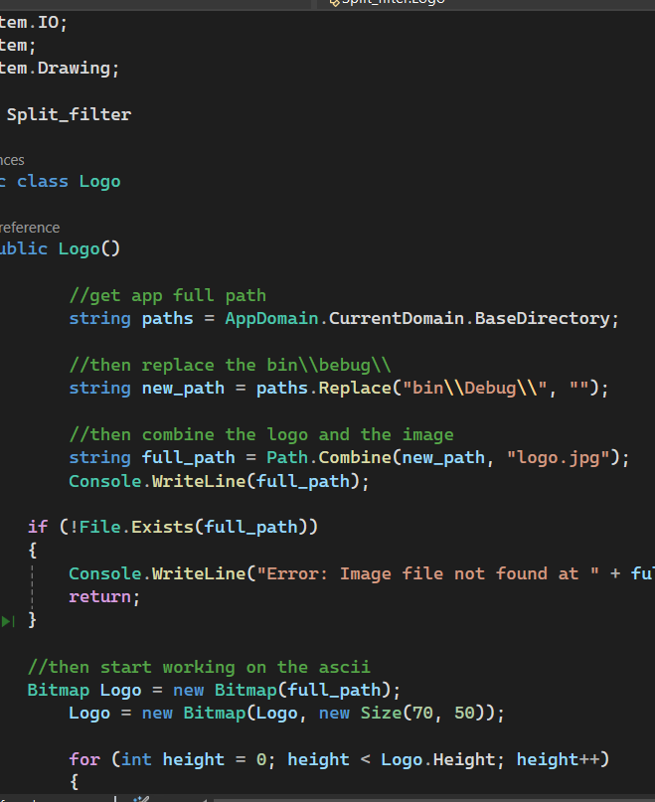
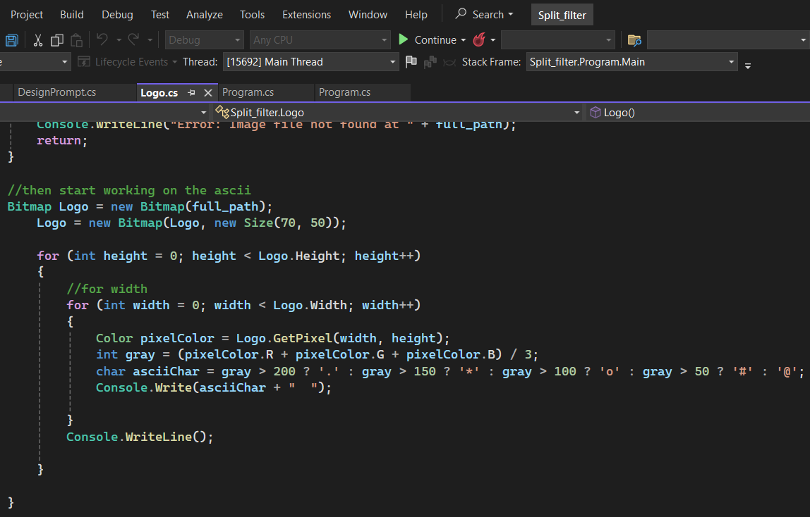
Logo code

Slide 6
Logo code explained:
Makes use of two imports; the first being the system.drawing for the ascii art and the system.IO to use the bitmap
Incoporated exception handling to display a message if the logo can not be found and displayed.
The directory is used to retrieves the full path of the currently running application.
Made use of ascii characters for the visual representation of the logo’s brightness.

Slide 7
Design prompt code

Slide 8
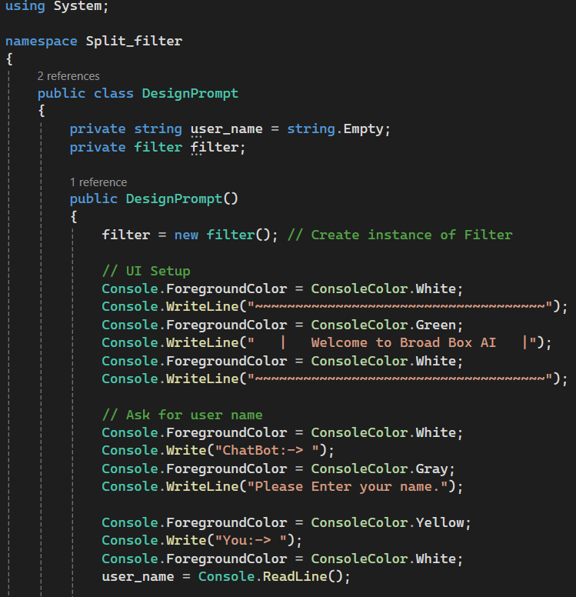
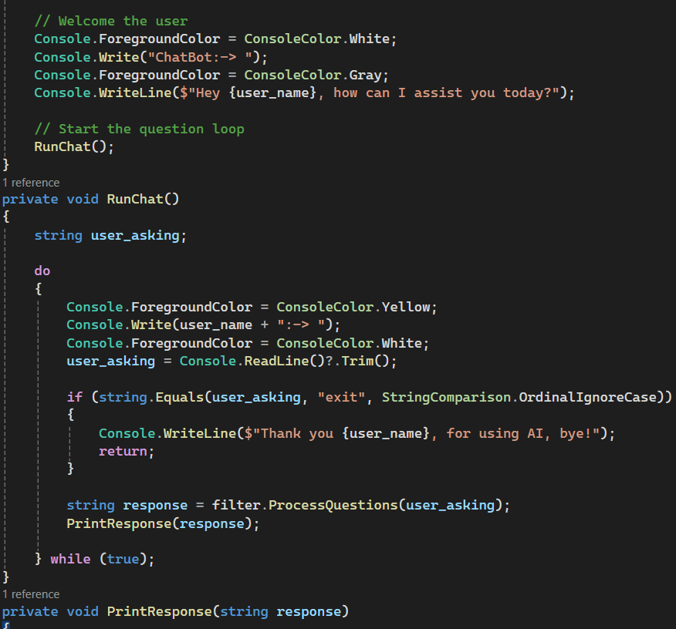
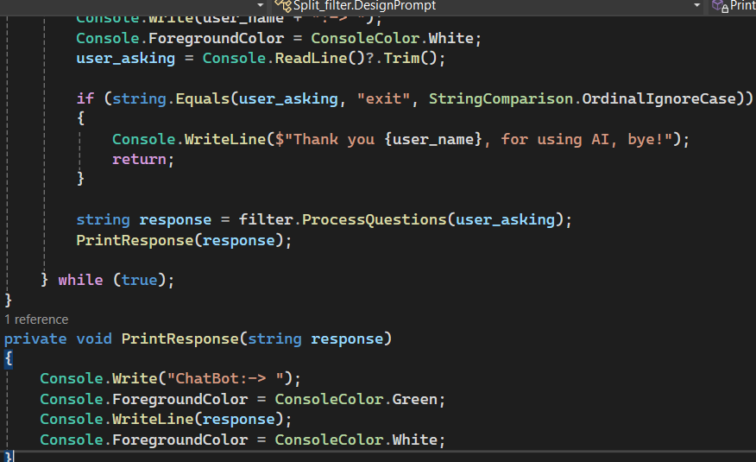

Slide 9
Designpromt code explained:
Used for user interaction as well as adding colour to the chatbot.
A do-while loop is used to continuously take user input, and stored in user_asking.
Console.ForegroundColor used to change the colour of the text.
Trim() method ensures no leading or trailing spaces.
Passes user_asking to the filter class for processing.
The response from filter.ProcessQuestions(user_asking) is then displayed.

Slide 10
filter code

Slide 11
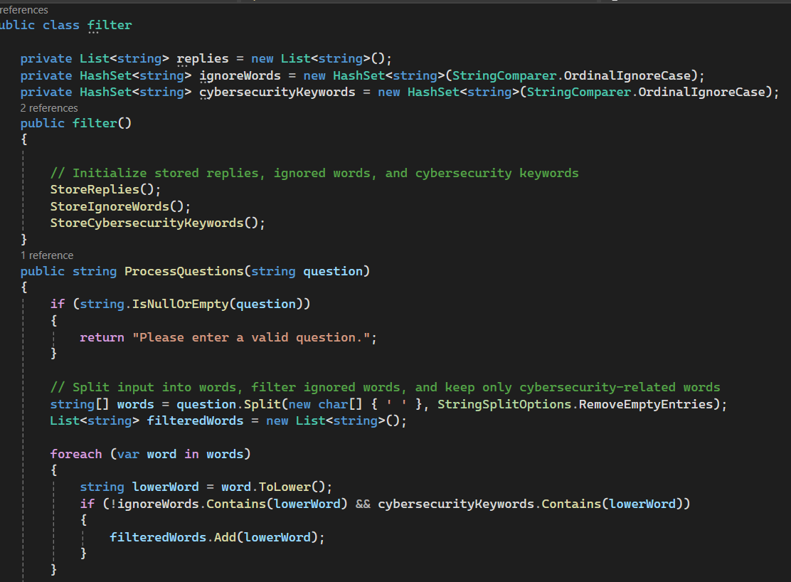
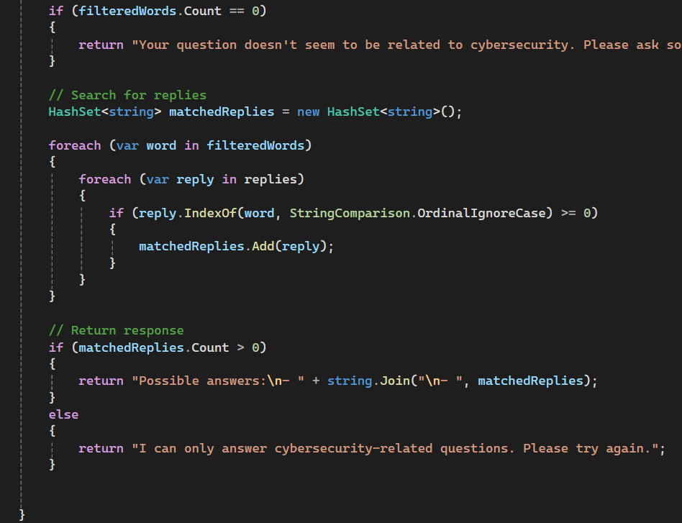

Slide 12
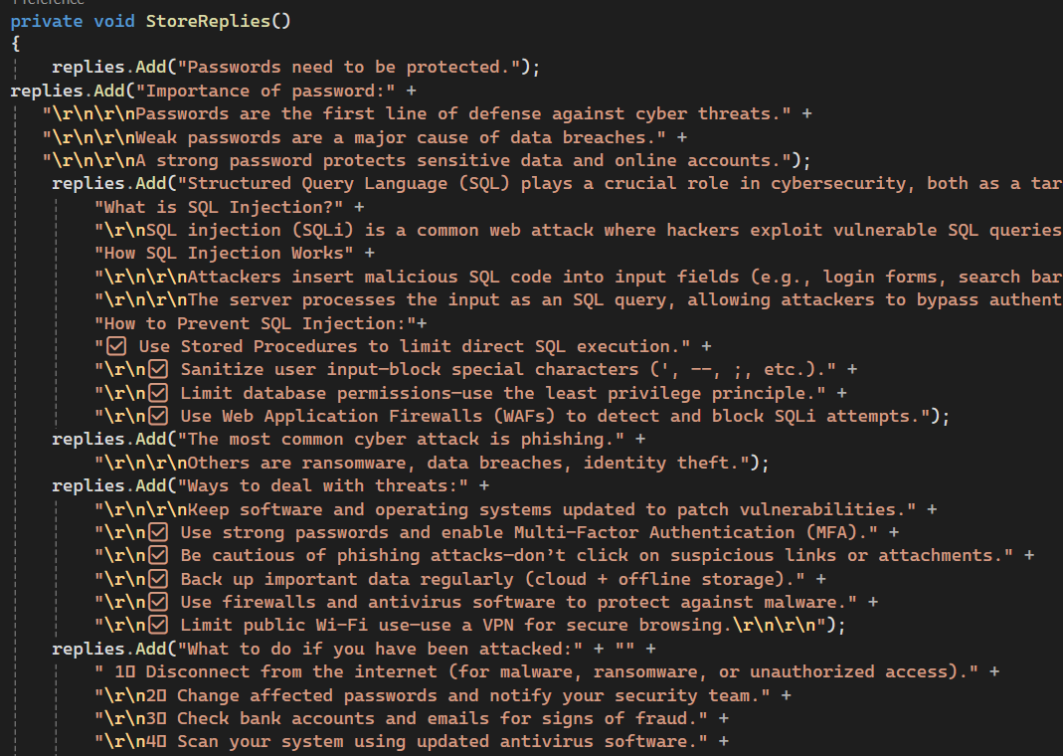
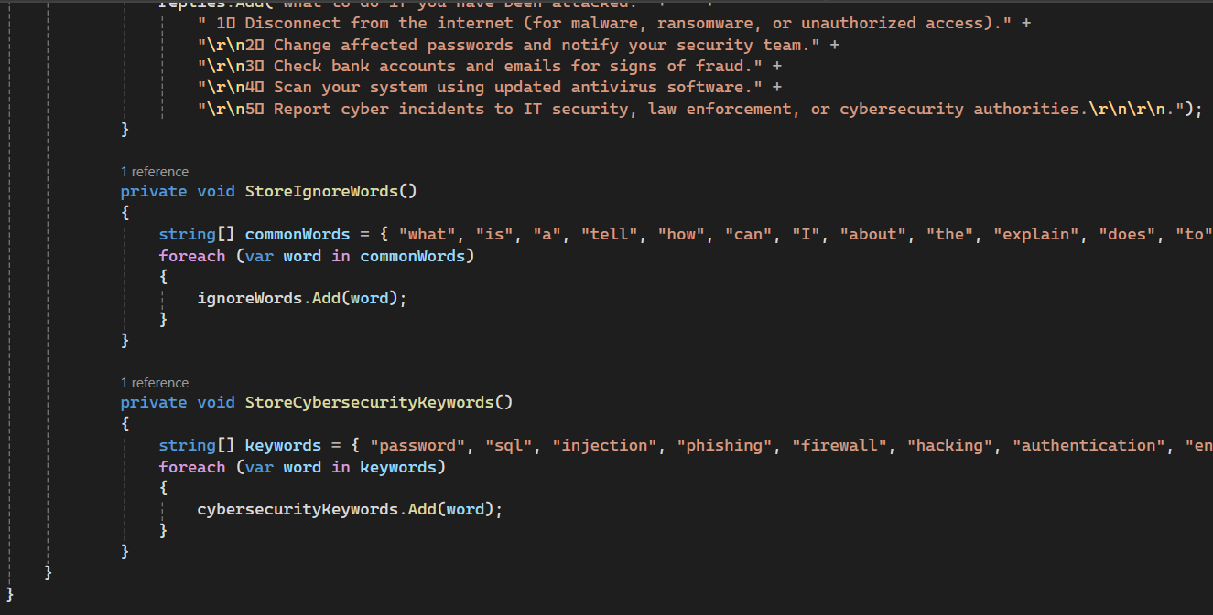

Slide 13
Filter code explained:
This code processes user queries and filters cybersecurity-related questions and responds with predefined responses.
Replies method : Stores predefined cybersecurity
responses.ignoreWords method : Stores common words to be ignored.
cybersecurityKeywords method : Stores cybersecurity-related words.
ProcessQuestions(string question): Splits input into words while filtering out ignored words, and it returns matched response.
Hashset<string> Used for better performance and prevents duplicate responses.
StringComparer.OrdinalIgnoreCase makes the HashSet case-insensitive

Slide 14
Final Product/results

Slide 15
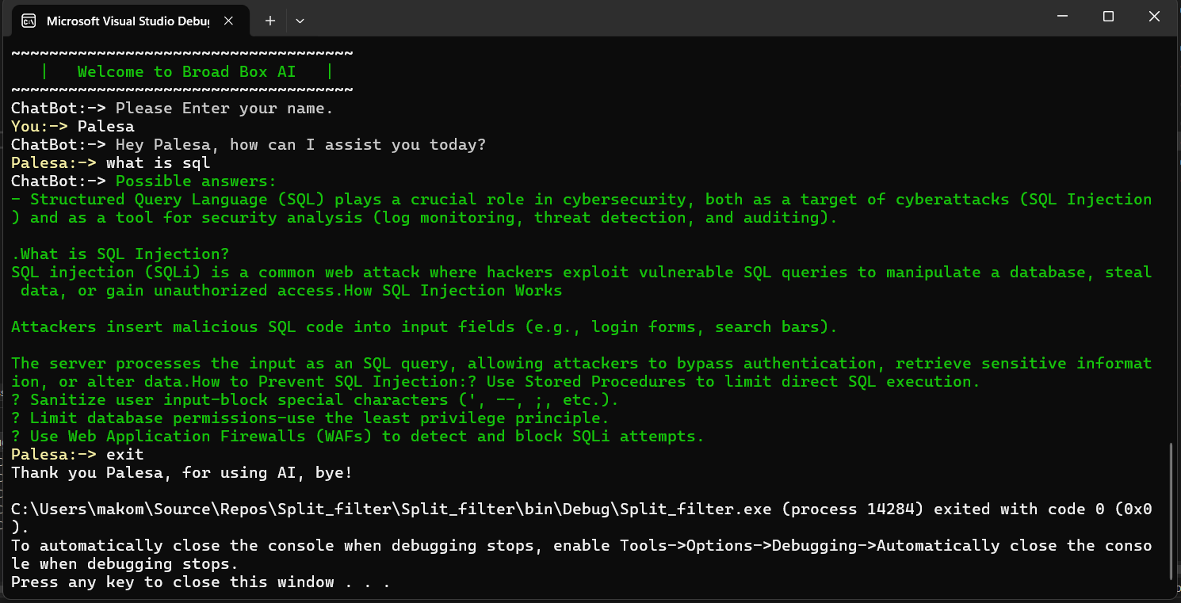

Slide 16
Final product explained
The picture from the previous slide shows how the code works and how well it interacts with the user and responds to the question asked.
It also shows how the program can stop once the user enters the word exit on the command line.

Slide 17
Thank you

